Slide 1
Corona Virus Analysis Project
Insights from Data Analysis

Slide 2
Contents
Introduction
Dataset Overview
Data Exploration and Analysis
Key Findings
Conclusion

Slide 3
Introduction
Objective: Analyzing a Corona Virus dataset to derive insights.
This presentation aims to showcase the analysis conducted on the Corona Virus dataset and the insights derived from it.

Slide 4
Dataset Overview
Description of the dataset columns:
Province: Geographic subdivision within a country/region. Country/Region: Geographic entity where data is recorded. Latitude: North-south position on Earth’s surface. Longitude: East-west position on Earth’s surface. Date: Recorded date of CORONA VIRUS data. Confirmed: Number of diagnosed CORONA VIRUS cases. Deaths: Number of CORONA VIRUS related deaths. Recovered: Number of recovered CORONA VIRUS cases.

Slide 5
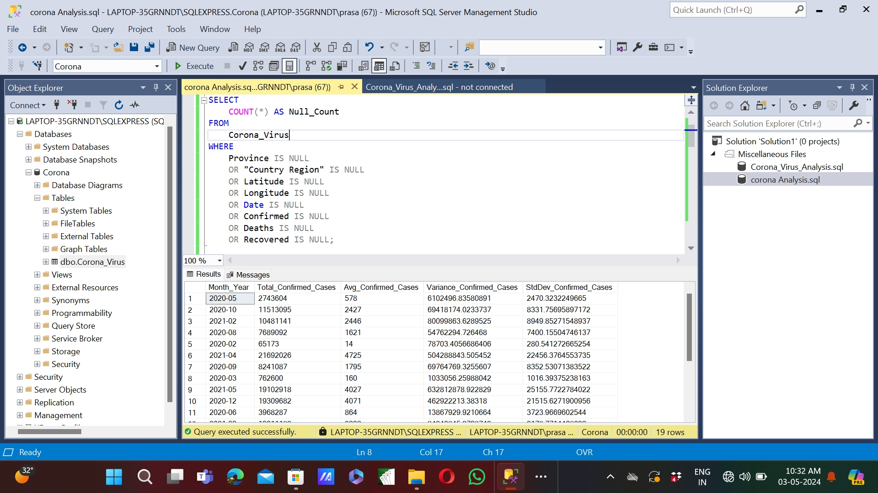
1.Write a code to check NULL values
Code to check NULL values

Slide 6
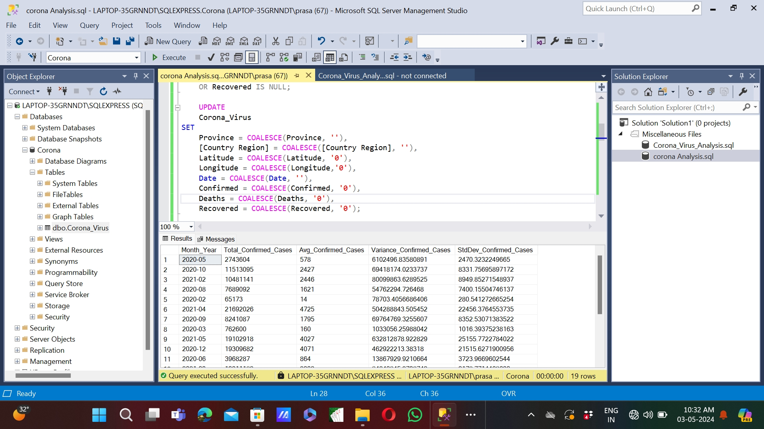
Q2. If NULL values are present, update them with zeros for all columns.
To update them with zeros for all columns.

Slide 7
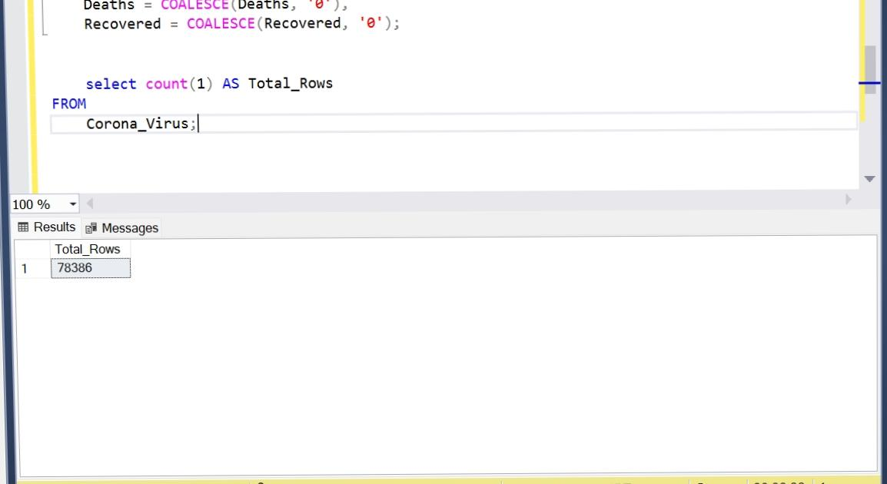
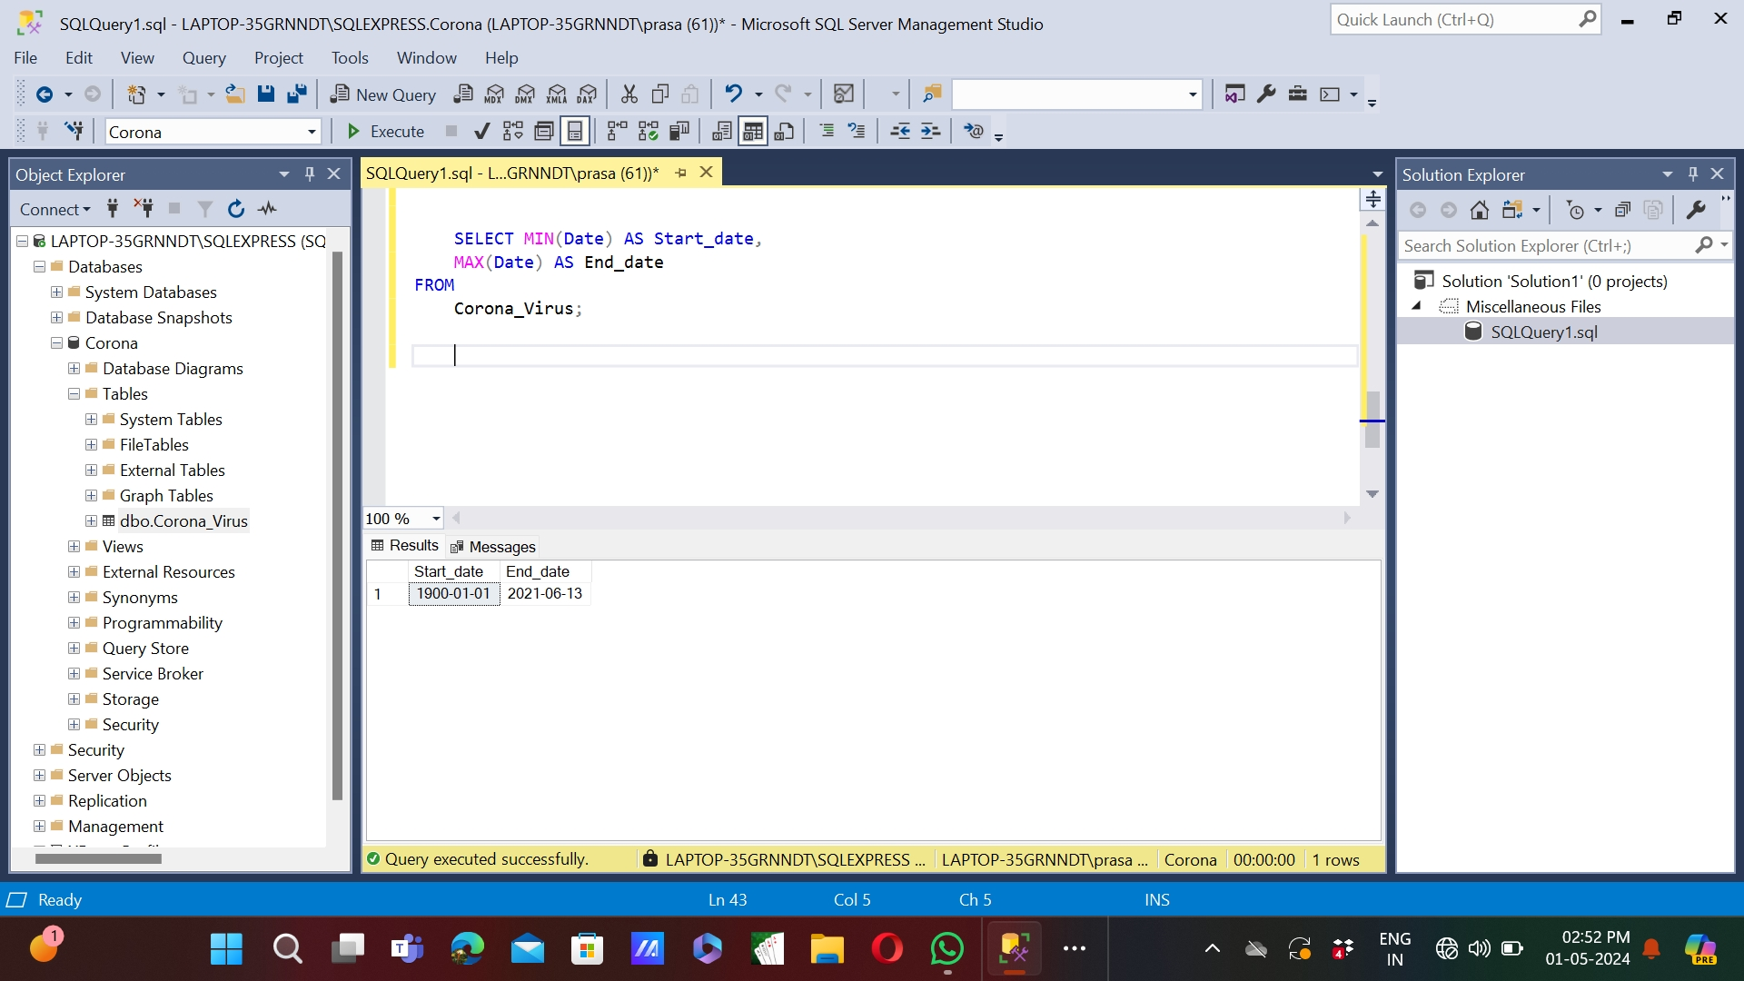
Q3. check total number of rows Q4. Check what is start_date and end_date
To check total number of rows
To Check what is start_date and end_date

Slide 8
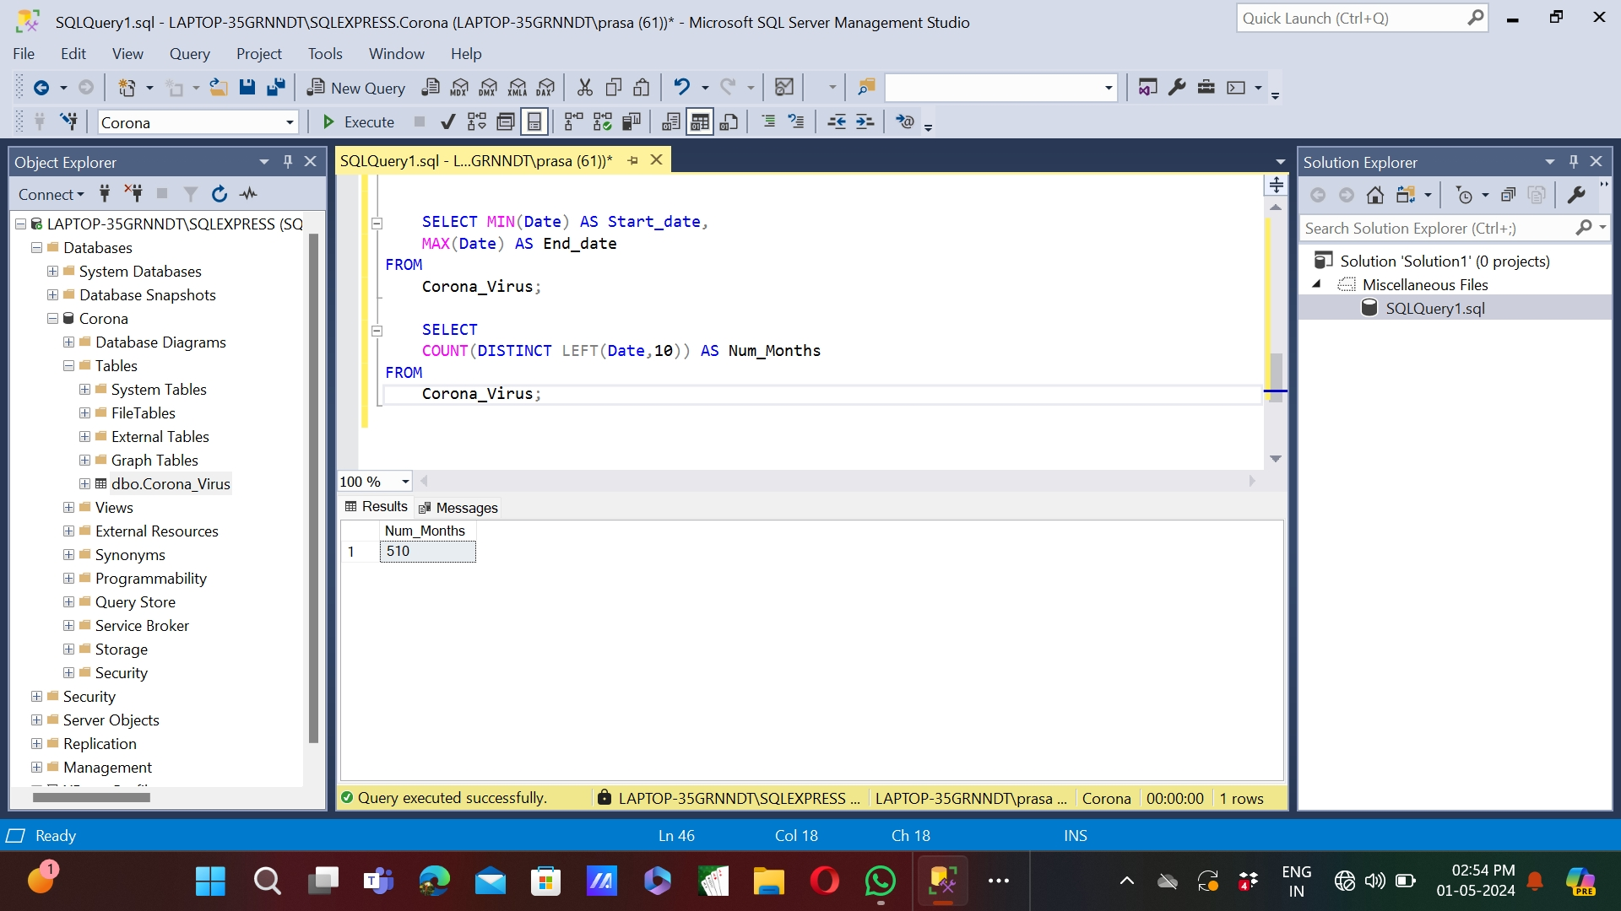
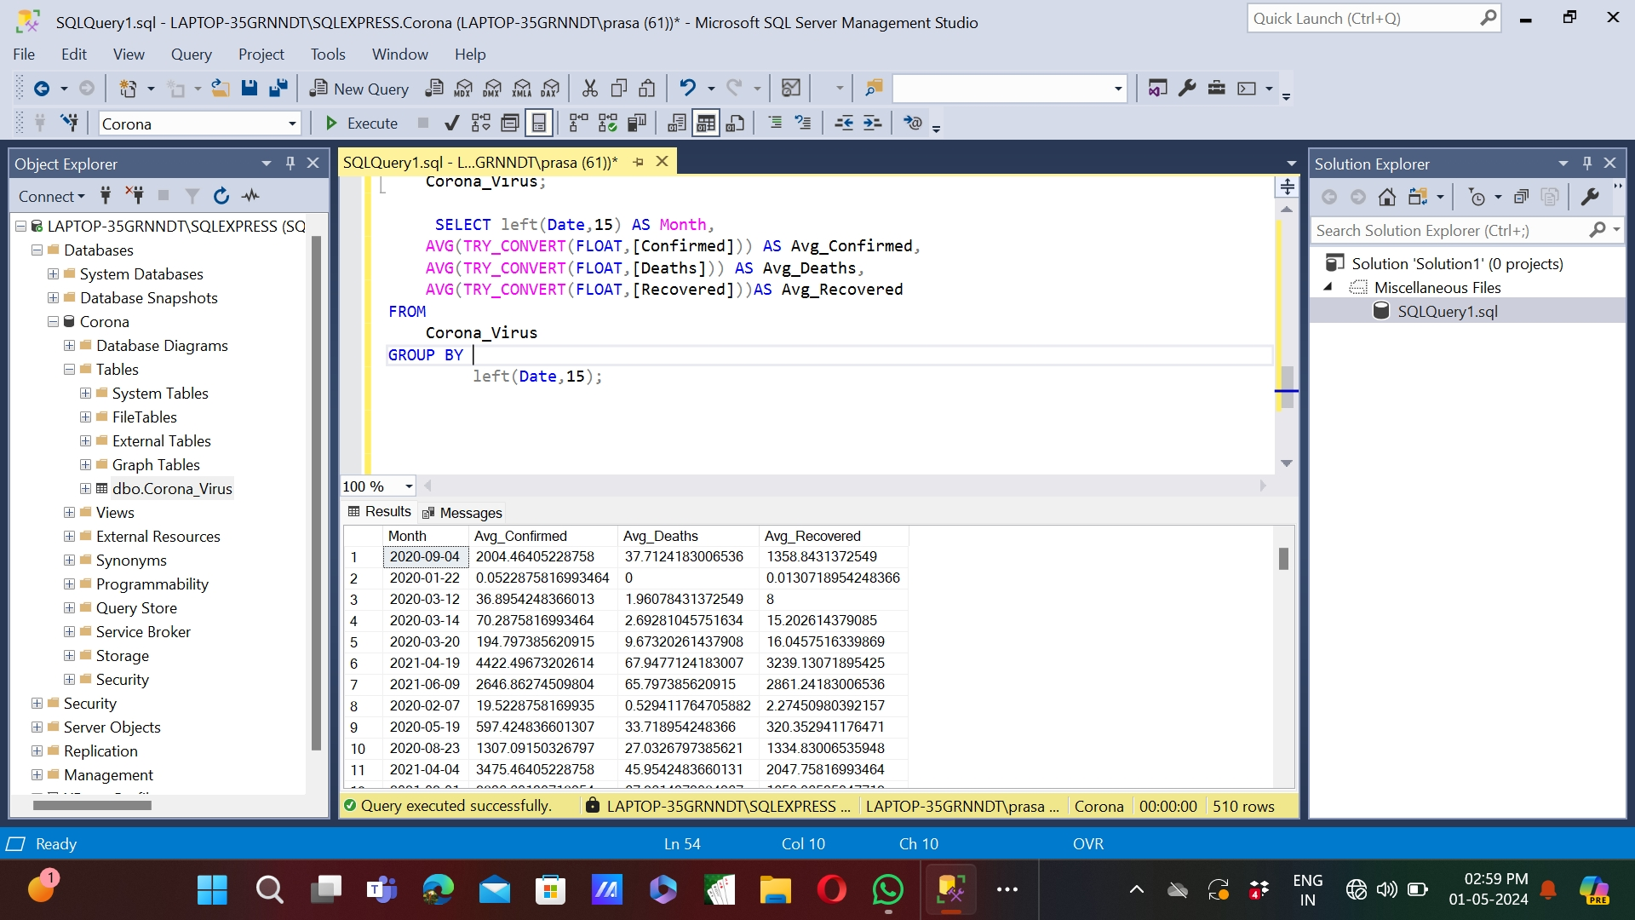
Q5. Number of months present in the dataset Q6. Find monthly average for confirmed, deaths, recovered
To Number of months present in the dataset
To Find monthly average for confirmed, deaths, recovered

Slide 9
Q7. Find most frequent value for confirmed, deaths, recovered each month
WITH MonthlyCounts AS ( SELECT LEFT(Date, 7) AS Month_Year, Confirmed, Deaths, Recovered, ROW_NUMBER() OVER(PARTITION BY LEFT(Date, 7) ORDER BY COUNT(*) DESC) AS Rank FROM Corona_Virus GROUP BY LEFT(Date, 7), Confirmed, Deaths, Recovered ) SELECT Month_Year, (SELECT TOP 1 Confirmed FROM MonthlyCounts WHERE Month_Year = MC.Month_Year GROUP BY Confirmed ORDER BY COUNT(*) DESC) AS Most_Frequent_Confirmed, (SELECT TOP 1 Deaths FROM MonthlyCounts WHERE Month_Year = MC.Month_Year GROUP BY Deaths ORDER BY COUNT(*) DESC) AS Most_Frequent_Deaths, (SELECT TOP 1 Recovered FROM MonthlyCounts WHERE Month_Year = MC.Month_Year GROUP BY Recovered ORDER BY COUNT(*) DESC) AS Most_Frequent_Recovered FROM (SELECT DISTINCT LEFT(Date , 7) AS Month_Year FROM Corona_Virus) As MC;

Slide 10
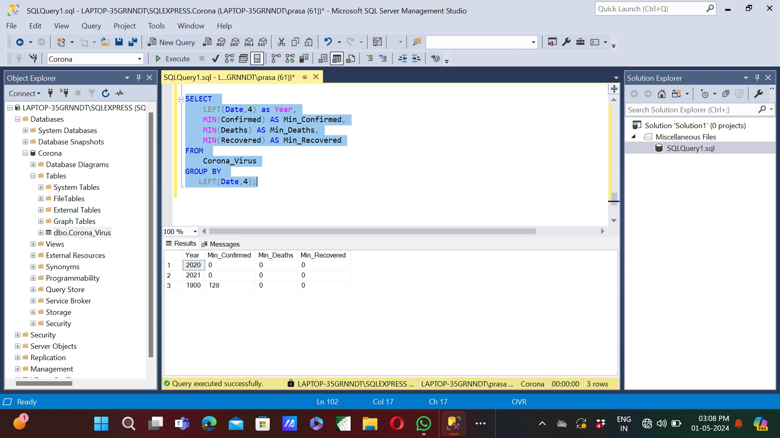
Q8. Find minimum values for confirmed, deaths, recovered per year
Minimum values for confirmed, deaths, recovered per year

Slide 11
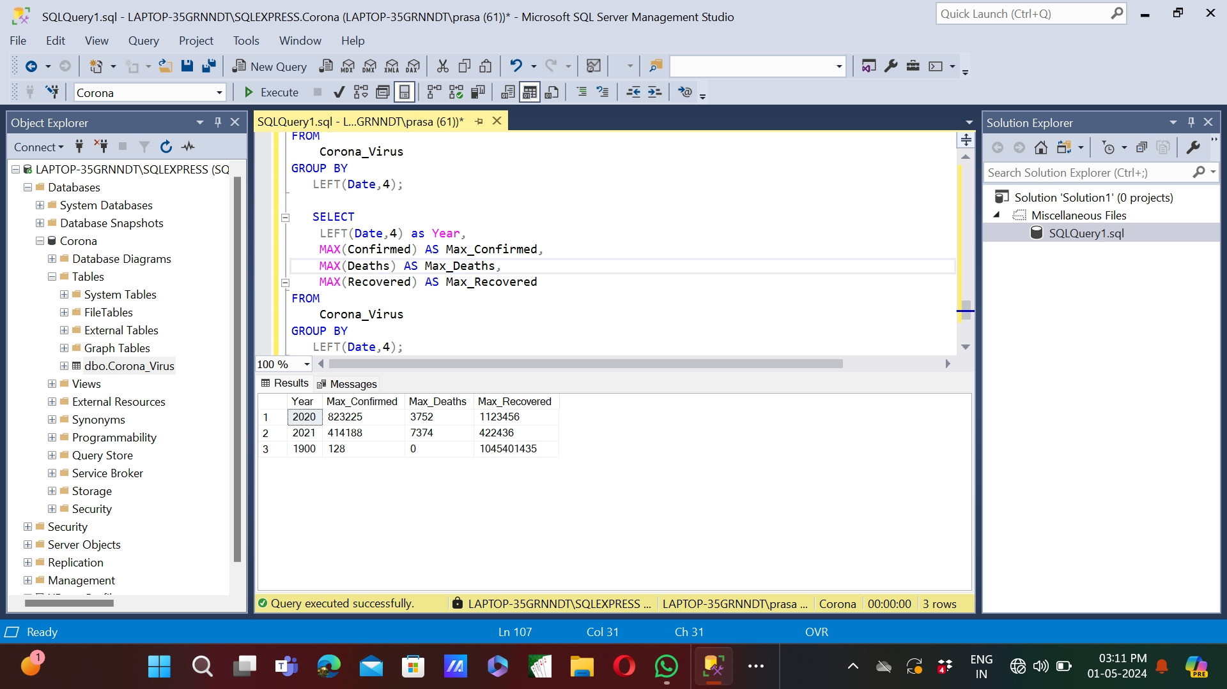
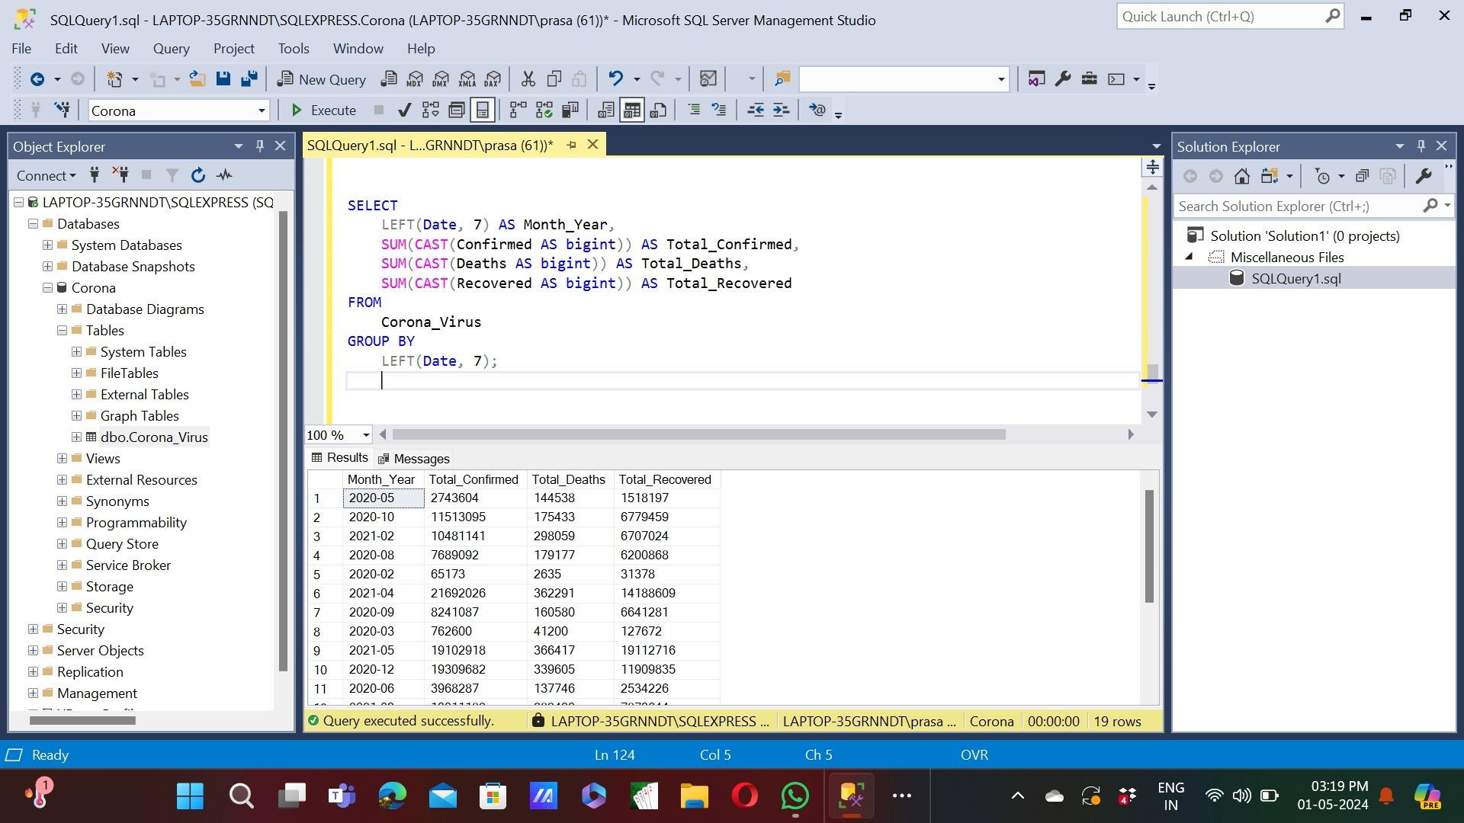
Q9. Find maximum values of confirmed, deaths, recovered per year Q10. The total number of cases of confirmed, deaths, recovered each month
Maximum values of confirmed, deaths, recovered per year
The total number of cases of confirmed, deaths, recovered each month

Slide 12
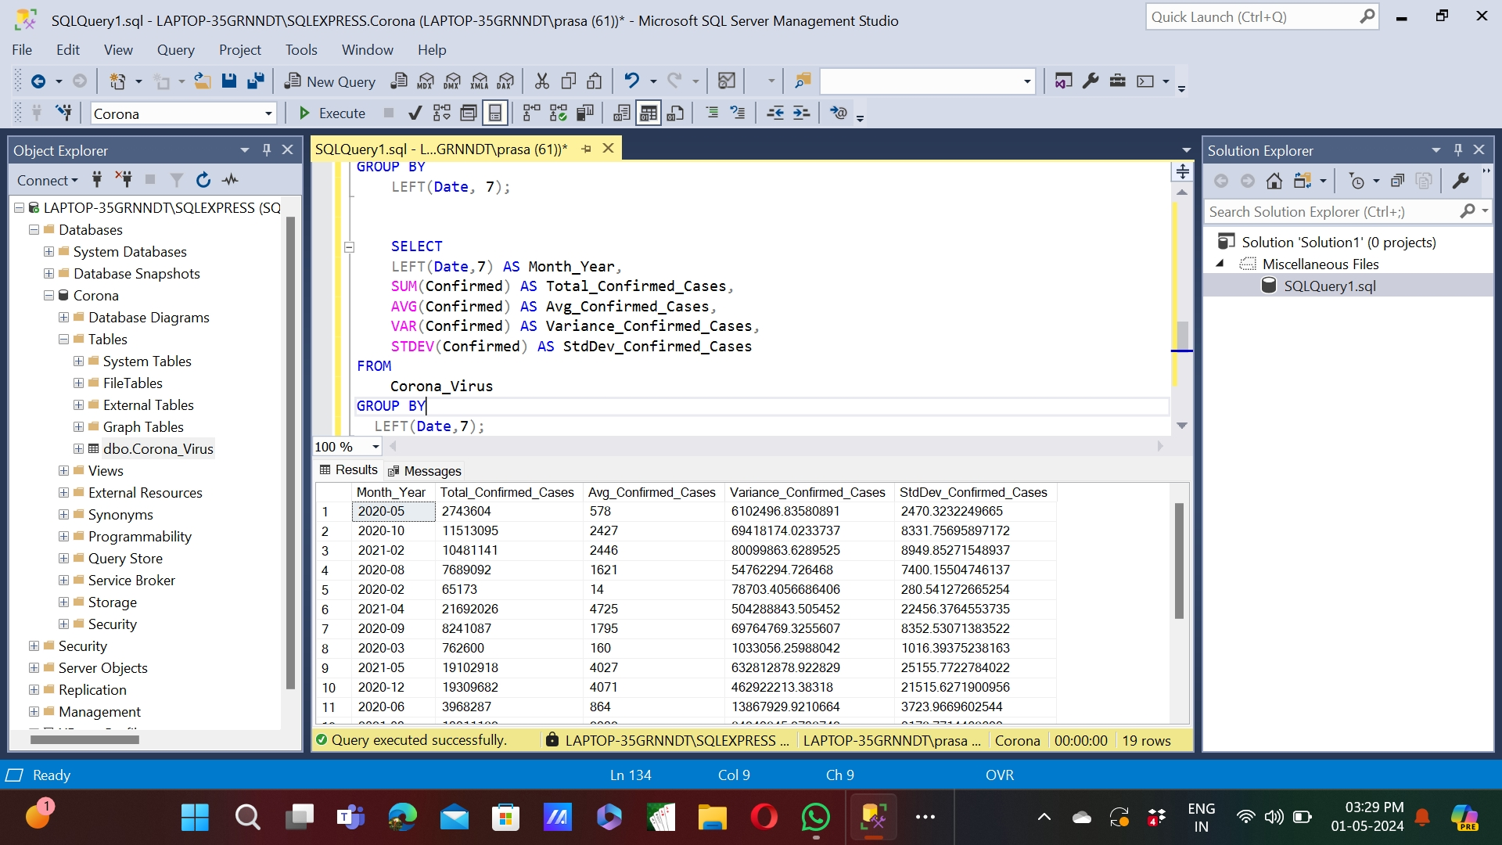
Q11. Check how coronavirus spread out with respect to confirmed cases
To Check how coronavirus spread out with respect to confirmed cases

Slide 13
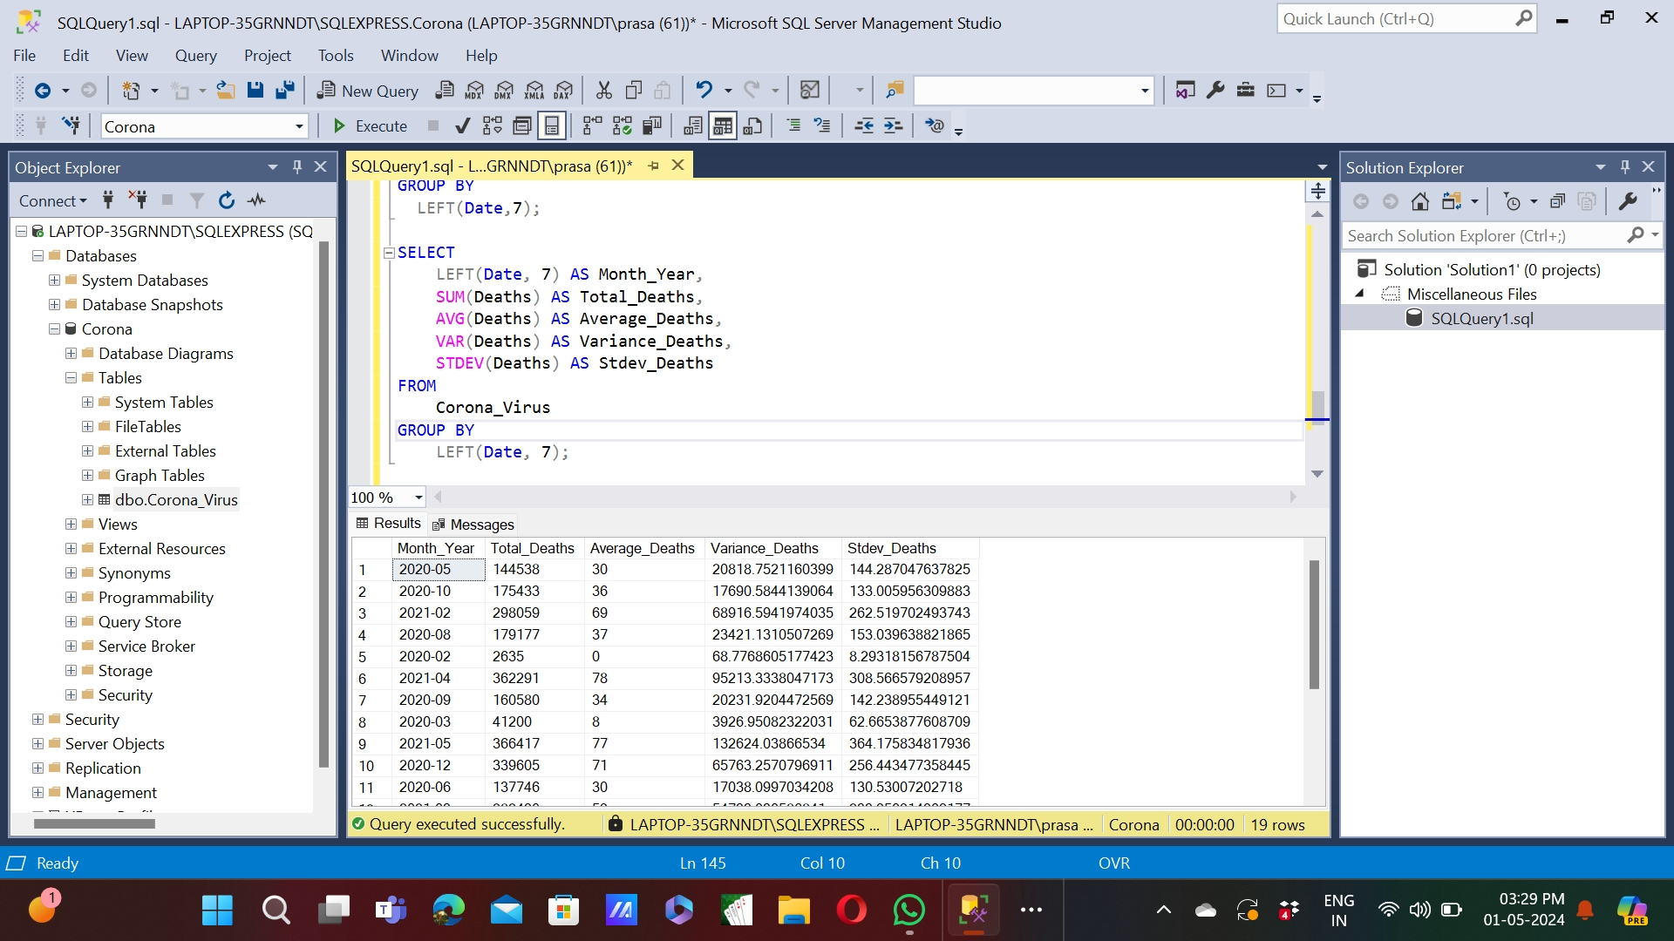
Q12. Check how coronavirus spread out with respect to death cases per month
To Check how coronavirus spread out with respect to death cases per month

Slide 14
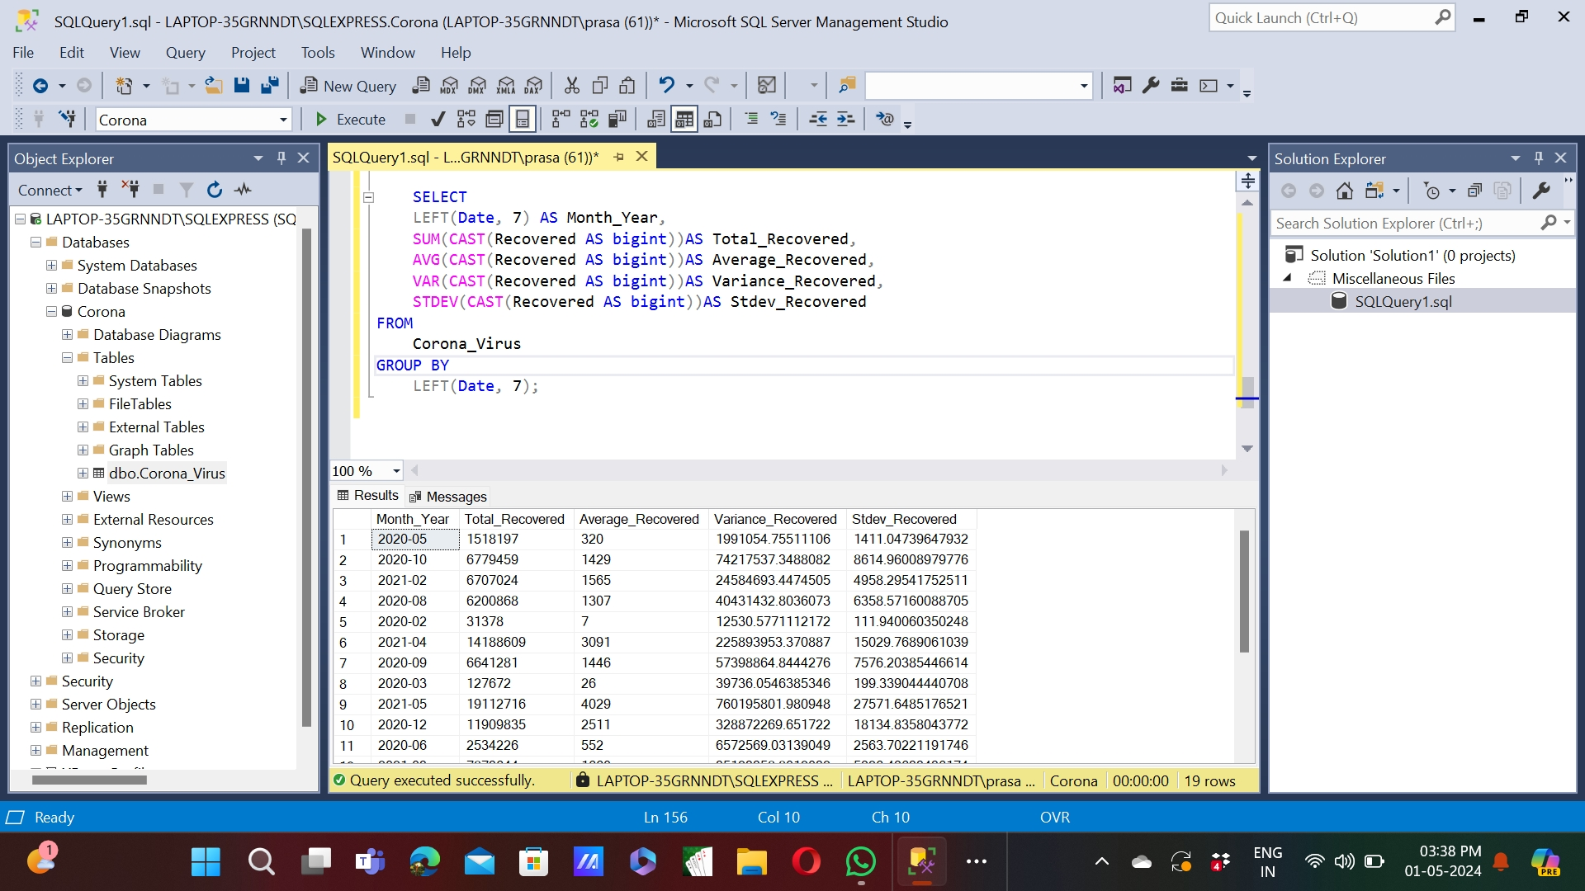
Q13. Check how coronavirus spread out with respect to recovered cases
To Check how coronavirus spread out with respect to recovered cases

Slide 15
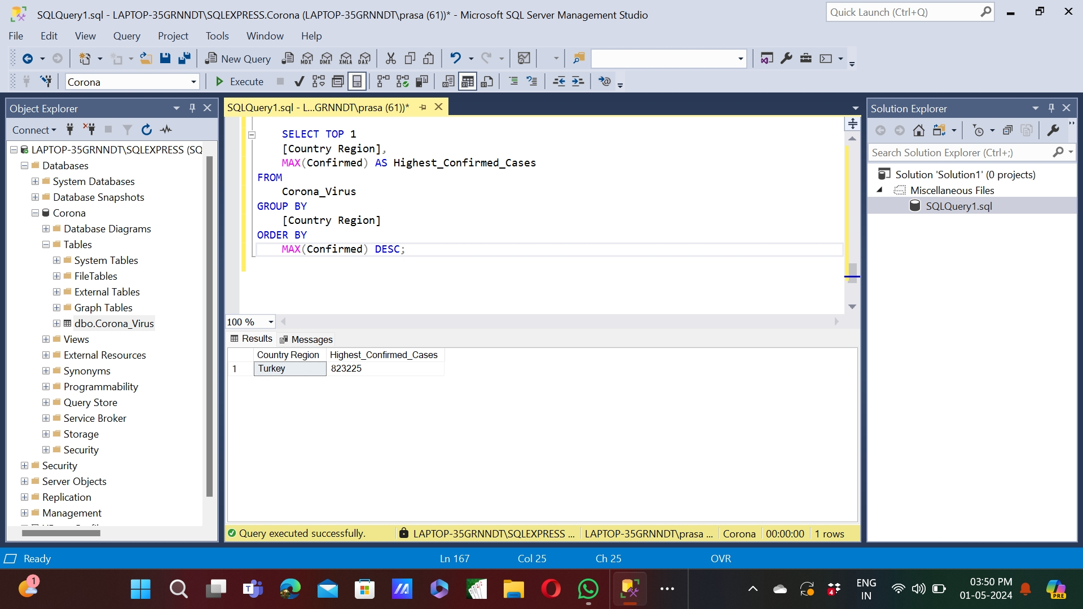
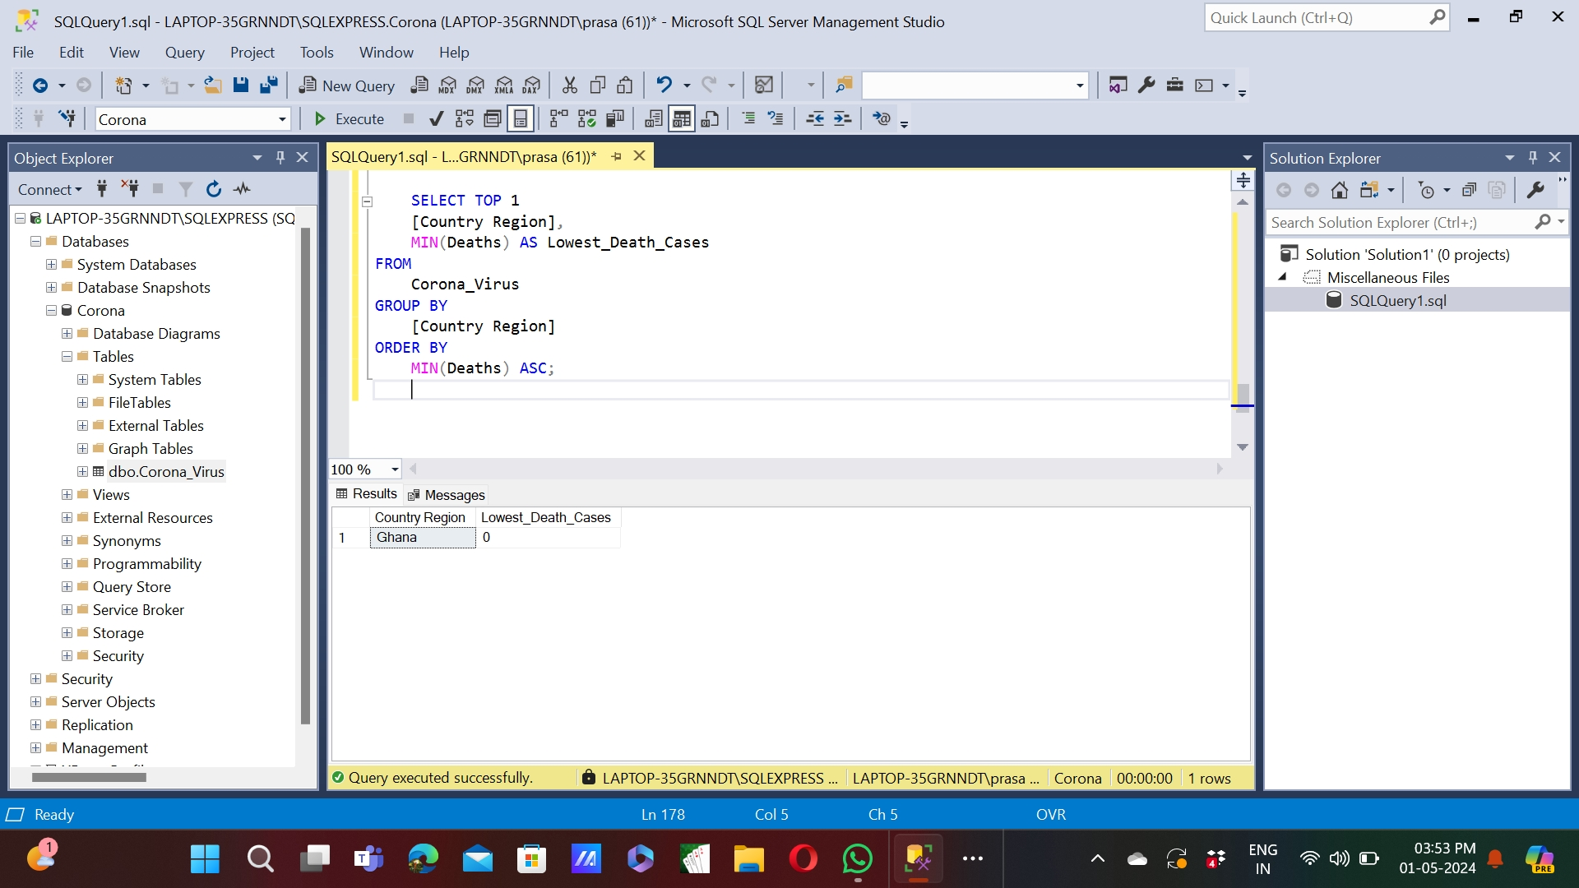
Q14. Find the Country having the highest number of confirmed cases Q15. Find the Country having the lowest number of death cases
To Find the Country having the highest number of confirmed cases
To Find the Country having the lowest number of death cases

Slide 16

Q16. Find the top 5 countries having the highest number of recovered cases
To Find the top 5 countries having the highest number of recovered cases

Slide 17
Key Findings
Monthly averages for confirmed cases, deaths, and recoveries provided a clear understanding of the progression of the pandemic. The most frequent values for confirmed cases, deaths, and recoveries each month highlighted the variability in the data. Analysis of minimum and maximum values per year revealed the extent of the pandemic’s impact over time. We identified Turkey as having the highest number of confirmed cases, underscoring the global spread of the virus. Conversely, Ghana recorded the lowest number of death cases, suggesting variations in healthcare systems and response efforts.
Finally, the top 5 countries with the highest number of recoveries demonstrated resilience and recovery efforts amid the pandemic.

Slide 18
Conclusion
In conclusion, our analysis of the COVID-19 dataset has provided valuable insights into the spread and impact of the virus. Through SQL queries, we were able to address various aspects of the data, including handling NULL values, calculating statistics, and identifying trends over time.

Slide 19


